Slide 1


Natural Language Processing Challenge
Abrar Alanazi
Rawan Alnajim
Nora Alshahrani
NLP Ninjas Group

Slide 2
Project Overview
Original Dataset:
- Dataset consists of 39,942 news articles with columns like label, title, text, subject, and date.
- Labels are binary (0 if the news is fake, 1 if the news is real).
Hypothesis:
- Investigate whether Natural Language Processing (NLP) techniques can effectively classify fake news articles.
- Hypothesize that by leveraging NLP models, we can accurately distinguish between fake and real news.

Slide 3
Data Cleaning and Analysis
Data Cleaning Process:
- Initial data exploration to understand the structure and content of the dataset.
- Handling missing values and duplicates.
- Text preprocessing steps such as lowercasing, tokenization, lemmatization, and stop-word removal.
Analysis Process:
- Feature engineering using TF-IDF vectorization for text data.
- Model training with Logistic Regression classifier.
- Evaluation metrics include accuracy and classification report.
sample_data:
we selected a representative sample of 1,000 data points (sample_data). This allows us to rapidly prototype and test our models while maintaining the core characteristics of the full dataset.

Slide 4
classical NLP model Model Building
classifiers used: Logistic Regression classifier for text classification tasks.
Training the classifier on the preprocessed text data using TF-IDF vectors.

Slide 5
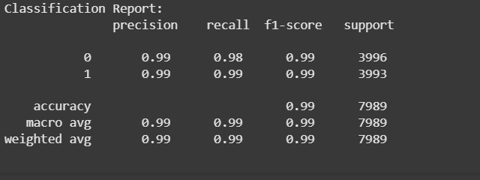
Model Evaluation
Accuracy: 0.9887345099511828

Slide 6
Word2Vec-based classifier
Objective: Classify text data using word embeddings and a machine learning model.
Model: XGBoost Classifier (XGBClassifier)
Embedding: Pre-trained GloVe (glove-wiki-gigaword-100)
Feature Extraction: Averaging word embeddings to create document vectors
Evaluation: Accuracy and classification metrics
Model: Random Forest Classifier
Embedding: Custom-trained Word2Vec model
Feature Extraction: Averaging word embeddings to create document vectors
Evaluation: Accuracy and classification metrics

Slide 7
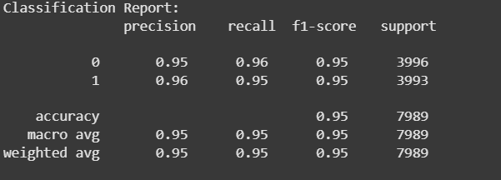
Random Forest Model Evaluation:
Model Accuracy: 0.9532

Slide 8
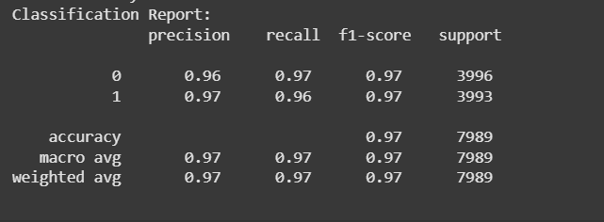
Model Evaluation: XGBClassifier
Model Accuracy: 0.9652

Slide 9
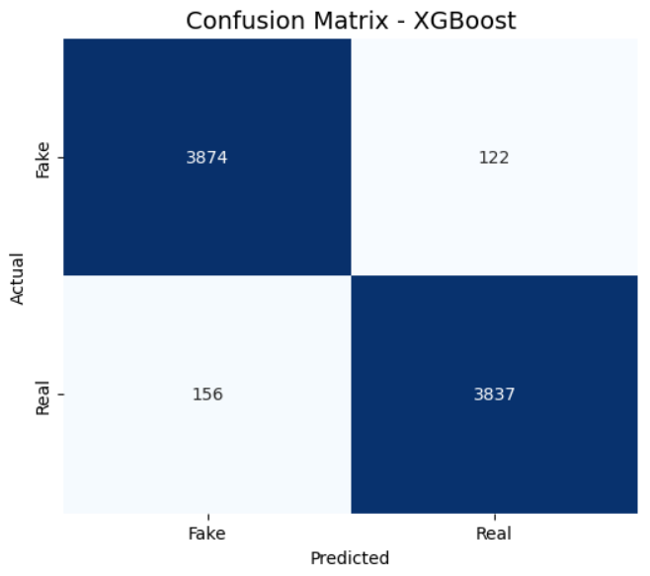
Confusion matrix

Slide 10
Conv1D-based Neural Network
Preprocess :
We first turn the text into strings and use a tokenizer with a 10,000-word vocabulary and an <OOV> token for unknown words. Then, we convert the text into number sequences, making sure they’re all 200 tokens long by padding or trimming. After that, we split the data into 80% for training and 20% for testing. Finally, we save the tokenizer to reuse later.
Embedding: Trainable embedding layer (128 dimensions)
Feature Extraction: Convolutional filters with max pooling

Slide 11
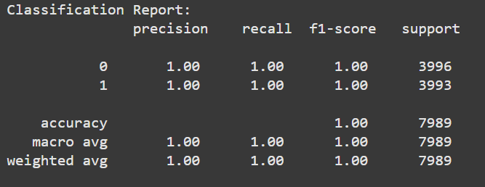
Model Evaluation:Conv1D
Model accuracy:9991

Slide 12
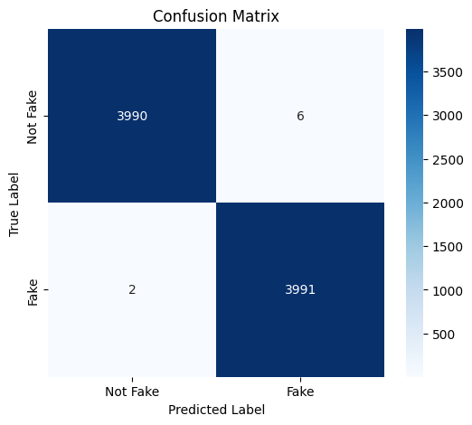
Confusion matrix
Conv1D

Slide 13
Conclusion
After testing different models, including Logistic Regression classifier
Random Forest with Word2Vec and XGBoost with GloVe embeddings, the Conv1D-based neural network outperformed them all. By leveraging trainable embeddings and convolutional layers, it effectively captured key patterns in the text, achieving an impressive 99.90% accuracy. This shows that deep learning, specifically Conv1D

Slide 14
Thank you for listening

